Slide 1

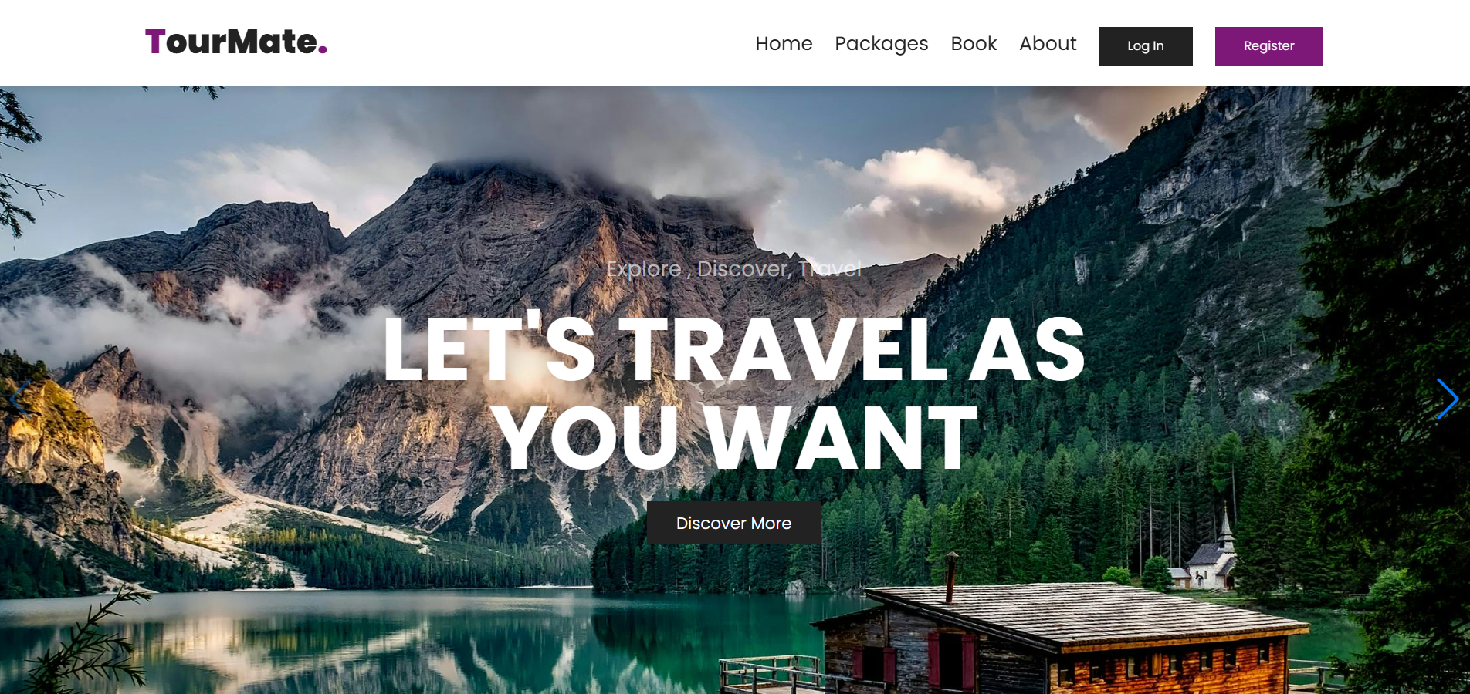

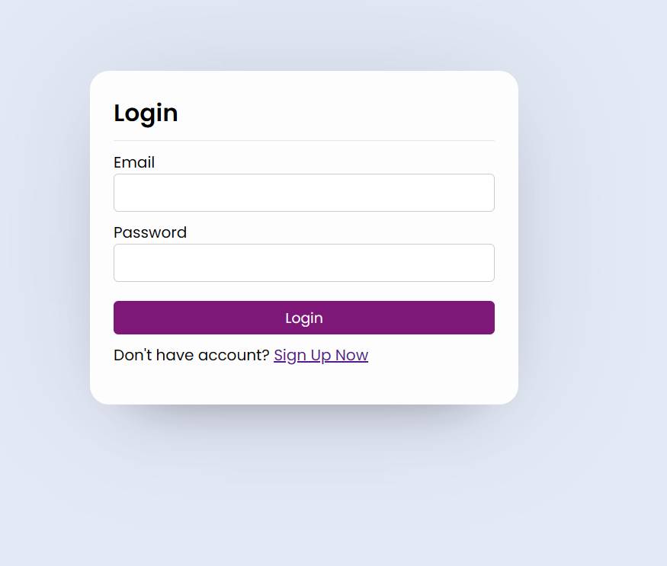
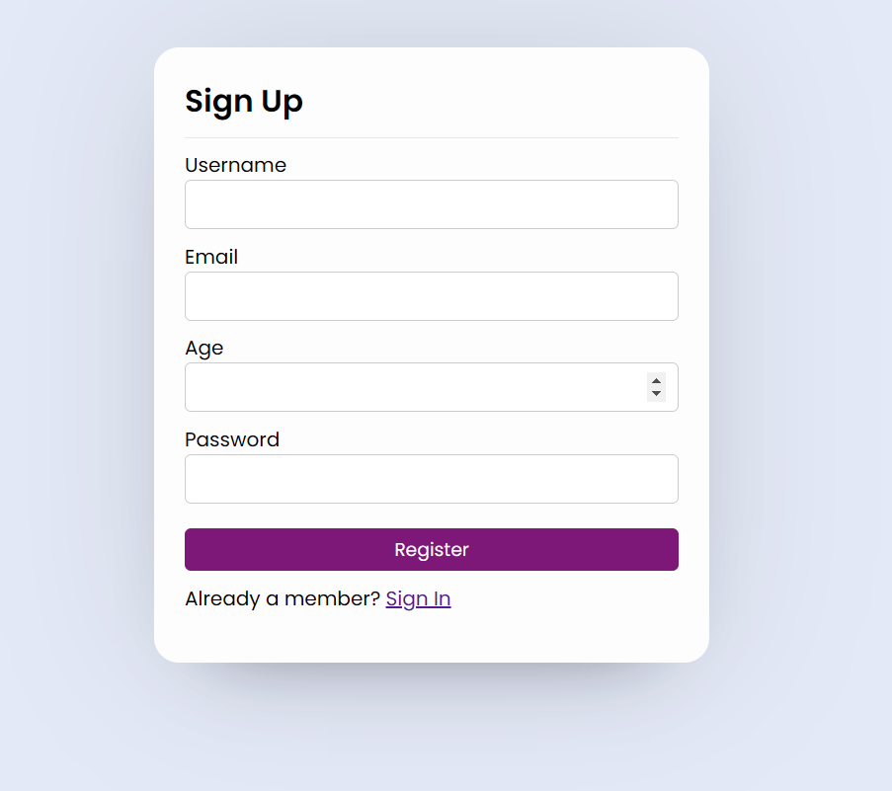
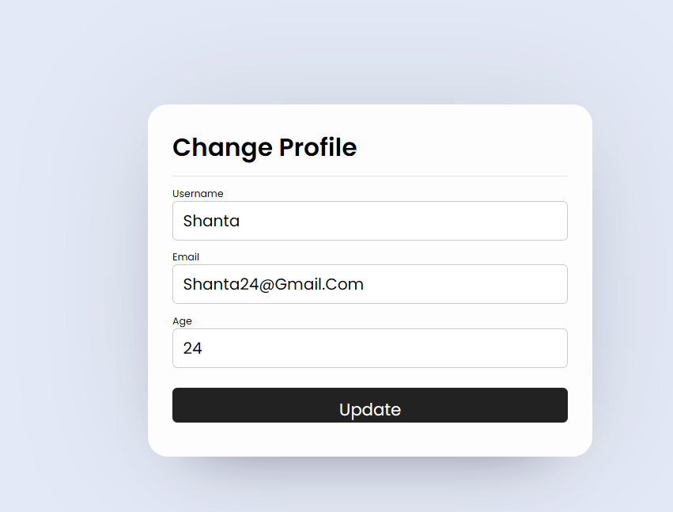

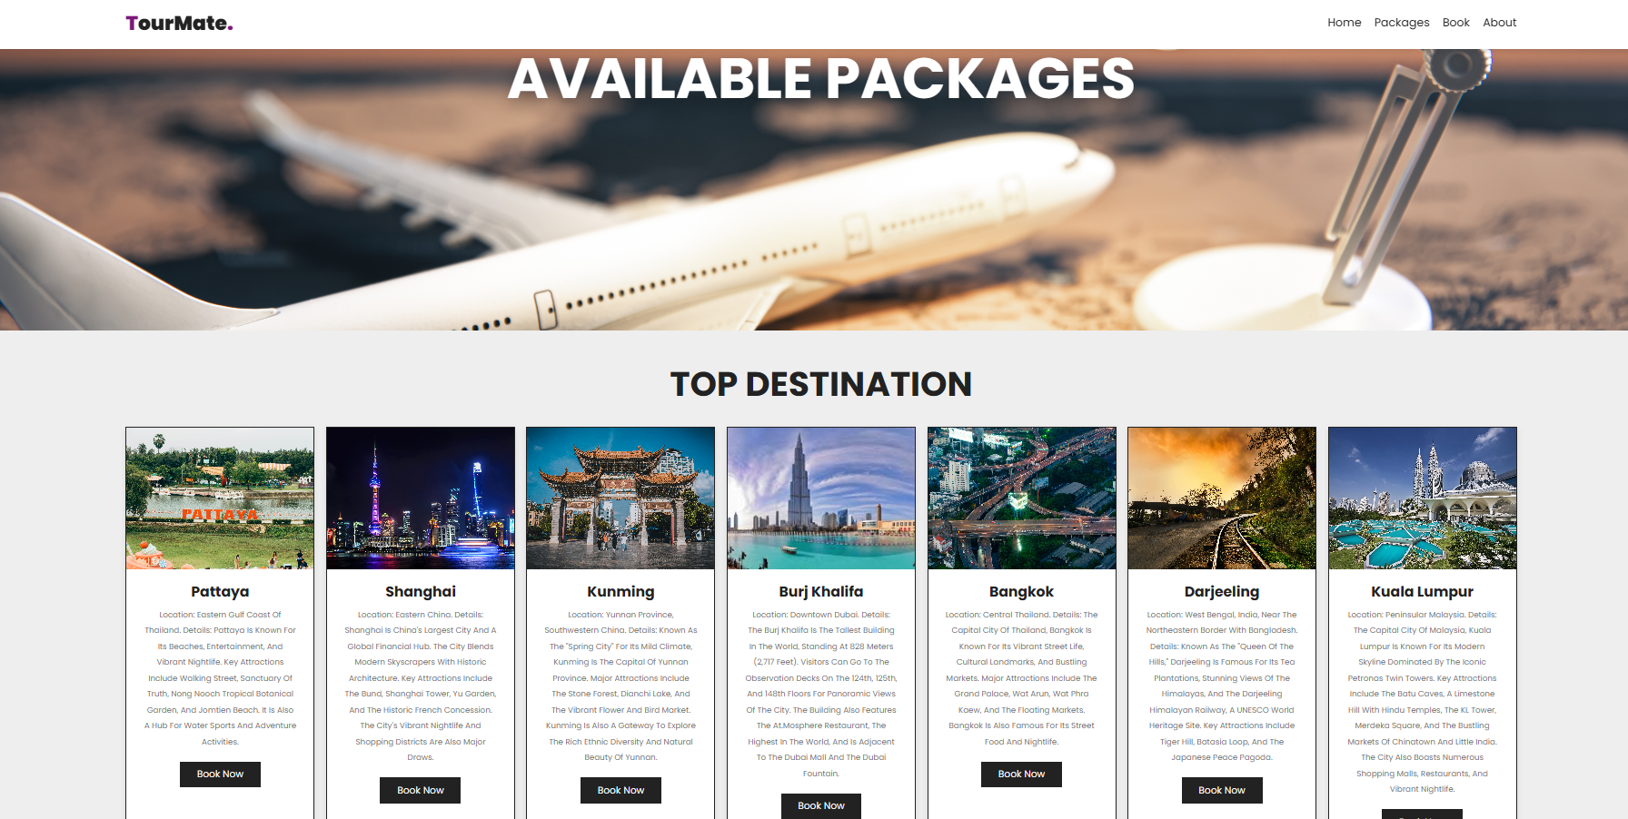
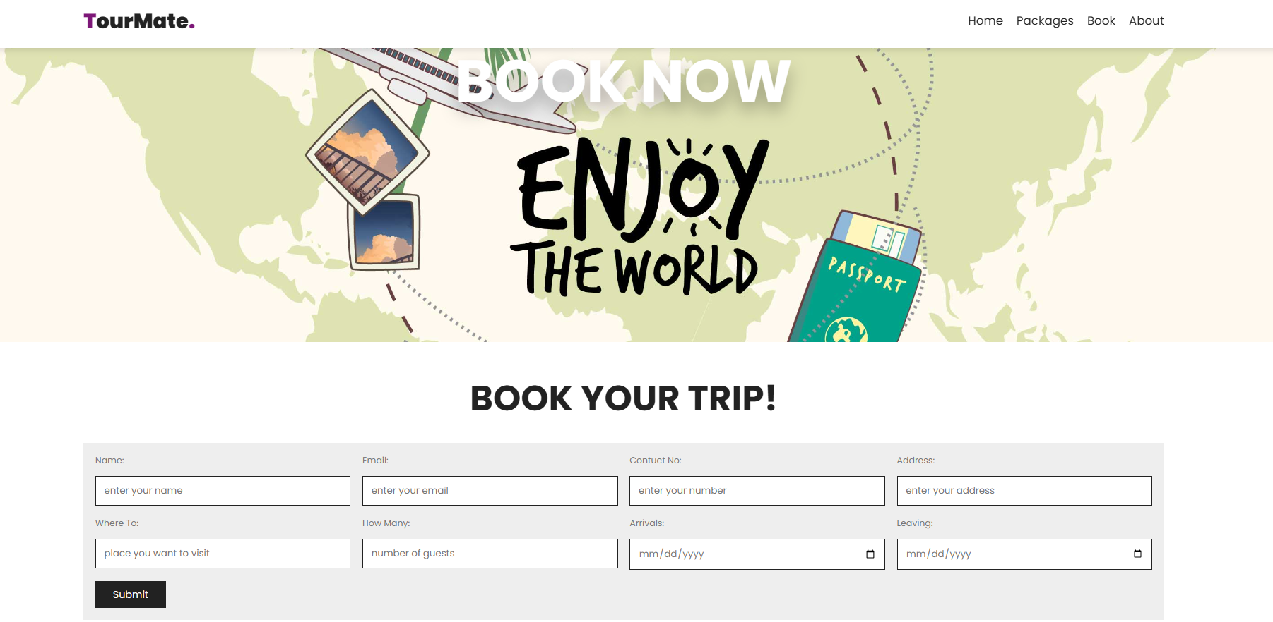
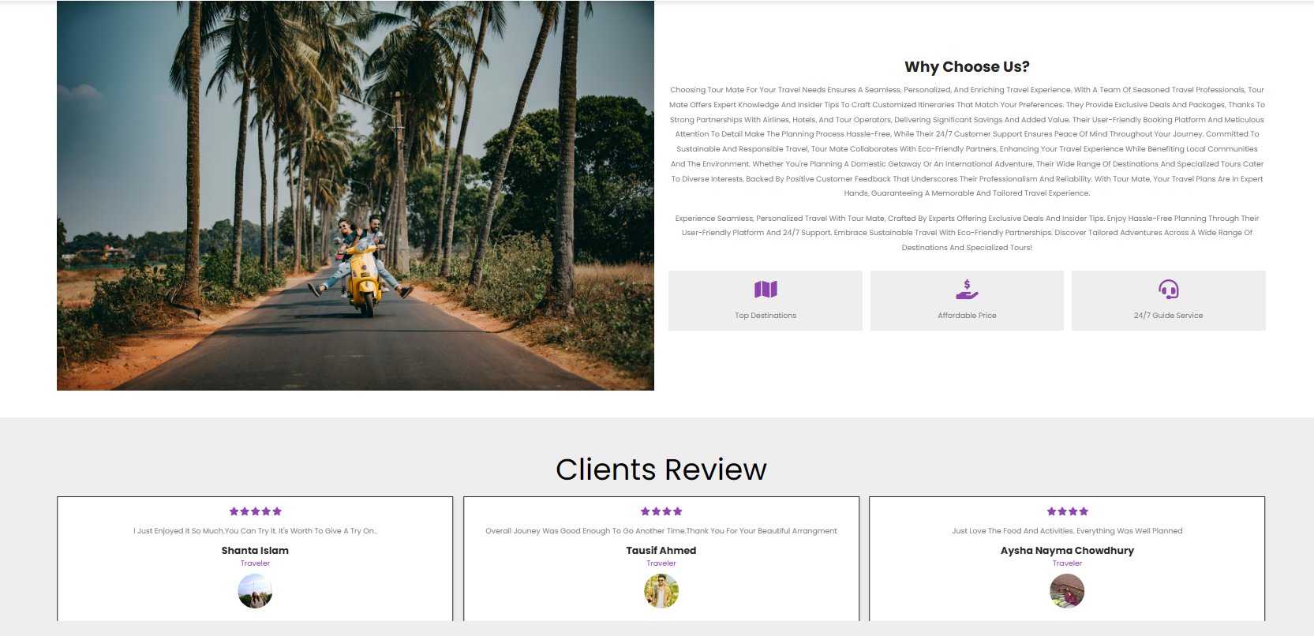


Travel management system
Introduction
Login & register interface
For registered customer they can easily access any packages and book it accordingly:
Change profile
It’s a website of travel management system which will help to book interesting tours to top attractive destinations. It’s also include tour packages and offers at most affordable prices. It’s easy to access and also helpful for admin purposes.
If customer wants than he can also change the profile
packages
Booking interface
Customer can explore packages that is offer by the company
About company and clients review
By filling up the form the customer can book his desirable tour
Customer can also see clients reviews and about the historical past of the company
limitations
User can’t get access of booking without registrations
Tour will only be confirmed after admin’s approval
It’s a user base website the admin functional access didn’t developed yet.
Project mentor:
Dr Shamim H Ripon
Professor
Department of computer science and engineering
Presented by:
Shanta islam
Tausif ahmed

